Slide 1
Troubling Traits:
Possible Extension Activity

Slide 2
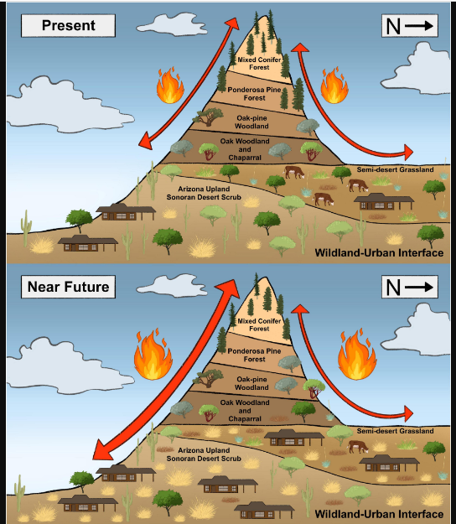
Based on many studies and considerable data, below is a graphic of scientists’ conclusions about our future with Buffelgrass.
The PRESENT graphic arrows show that fires with Buffelgrass occur in Ponderosa Pine Forest zones. The flame graphic represents the size of the fires.
The NEAR FUTURE graphic arrows show the fires will be moving down into the Oak Pine Woodland zone and the flame shows the fires as burning bigger and hotter.
Notes:
Teacher hands out Evaluation. Teacher reads aloud the situation and the directions. Encourage students to refer to the Rubric.

Slide 3
The City of Tucson must come up with a plan to prevent the 50 year prediction from becoming a reality.
Below are descriptions of three different Buffelgrass Stakeholders that attended the City Council meeting. Read the description of each Stakeholder and their plan to solve the Buffelgrass problem so the future predicted in the graphic does not come true. Evaluate each Stakeholder’s plan and choose which Stakeholder’s plan should be implemented and why. Make sure you use evidence as you argue why the Stakeholder’s plan you support is the best solution.
Stakeholder
Notes:
Teacher may need to explain what a City Council meeting is and will need to clarify what a Stakeholder is.

Slide 4
Stakeholder | Buffelgrass Area of Concern | Proposed Solution
Homeowners Association HOA (an organization that makes and enforces rules and guidelines for a subdivision, planned community, or condominium building.) | The neighborhood is located next to the city’s Urban Trail used by joggers, cyclists, walkers, etc. The Urban Trail is asphalt, but is bordered by significant patches of land infested with Buffelgrass. | Neighborhood residents and surrounding residents, as well as businesses and other community members schedule and participate in Buffelgrass Pulls. Buffelgrass will be manually pulled up by the roots, bagged, and thrown away.
Rancher (owns 150 head of cattle) | Although the US outlawed Buffelgrass in the 1980s, Mexico still plants Buffelgrass. This rancher’s land borders Sonora, Mexico. This rancher has 350 acres of land bordering Sonora. Significant stretches of the rancher’s fence line border buffelgrass patches. | Allow the 150 cattle to eat/graze in the infested areas.
Arizona Department of Transportation (transportation agency responsible for planning, building,operating maintaining highways & is involved with maintaining public transportation and municipal airports | From Tucson to Mexico, along the 1-19 corridor, several areas are infested with Buffelgrass. These areas border I-10 in both directions. More than 12 medians have been identified as being infested with Buffelgrass. | ADOT will spray herbicide when the plant starts to turn green, when the herbicide is most effective.The area in focus will be between Continental and Duval Mine roads in the Green Valley area. Medians, shoulders and frontage roads will be addressed.
Notes:
Teacher reviews information and clarifies directions.

Slide 5
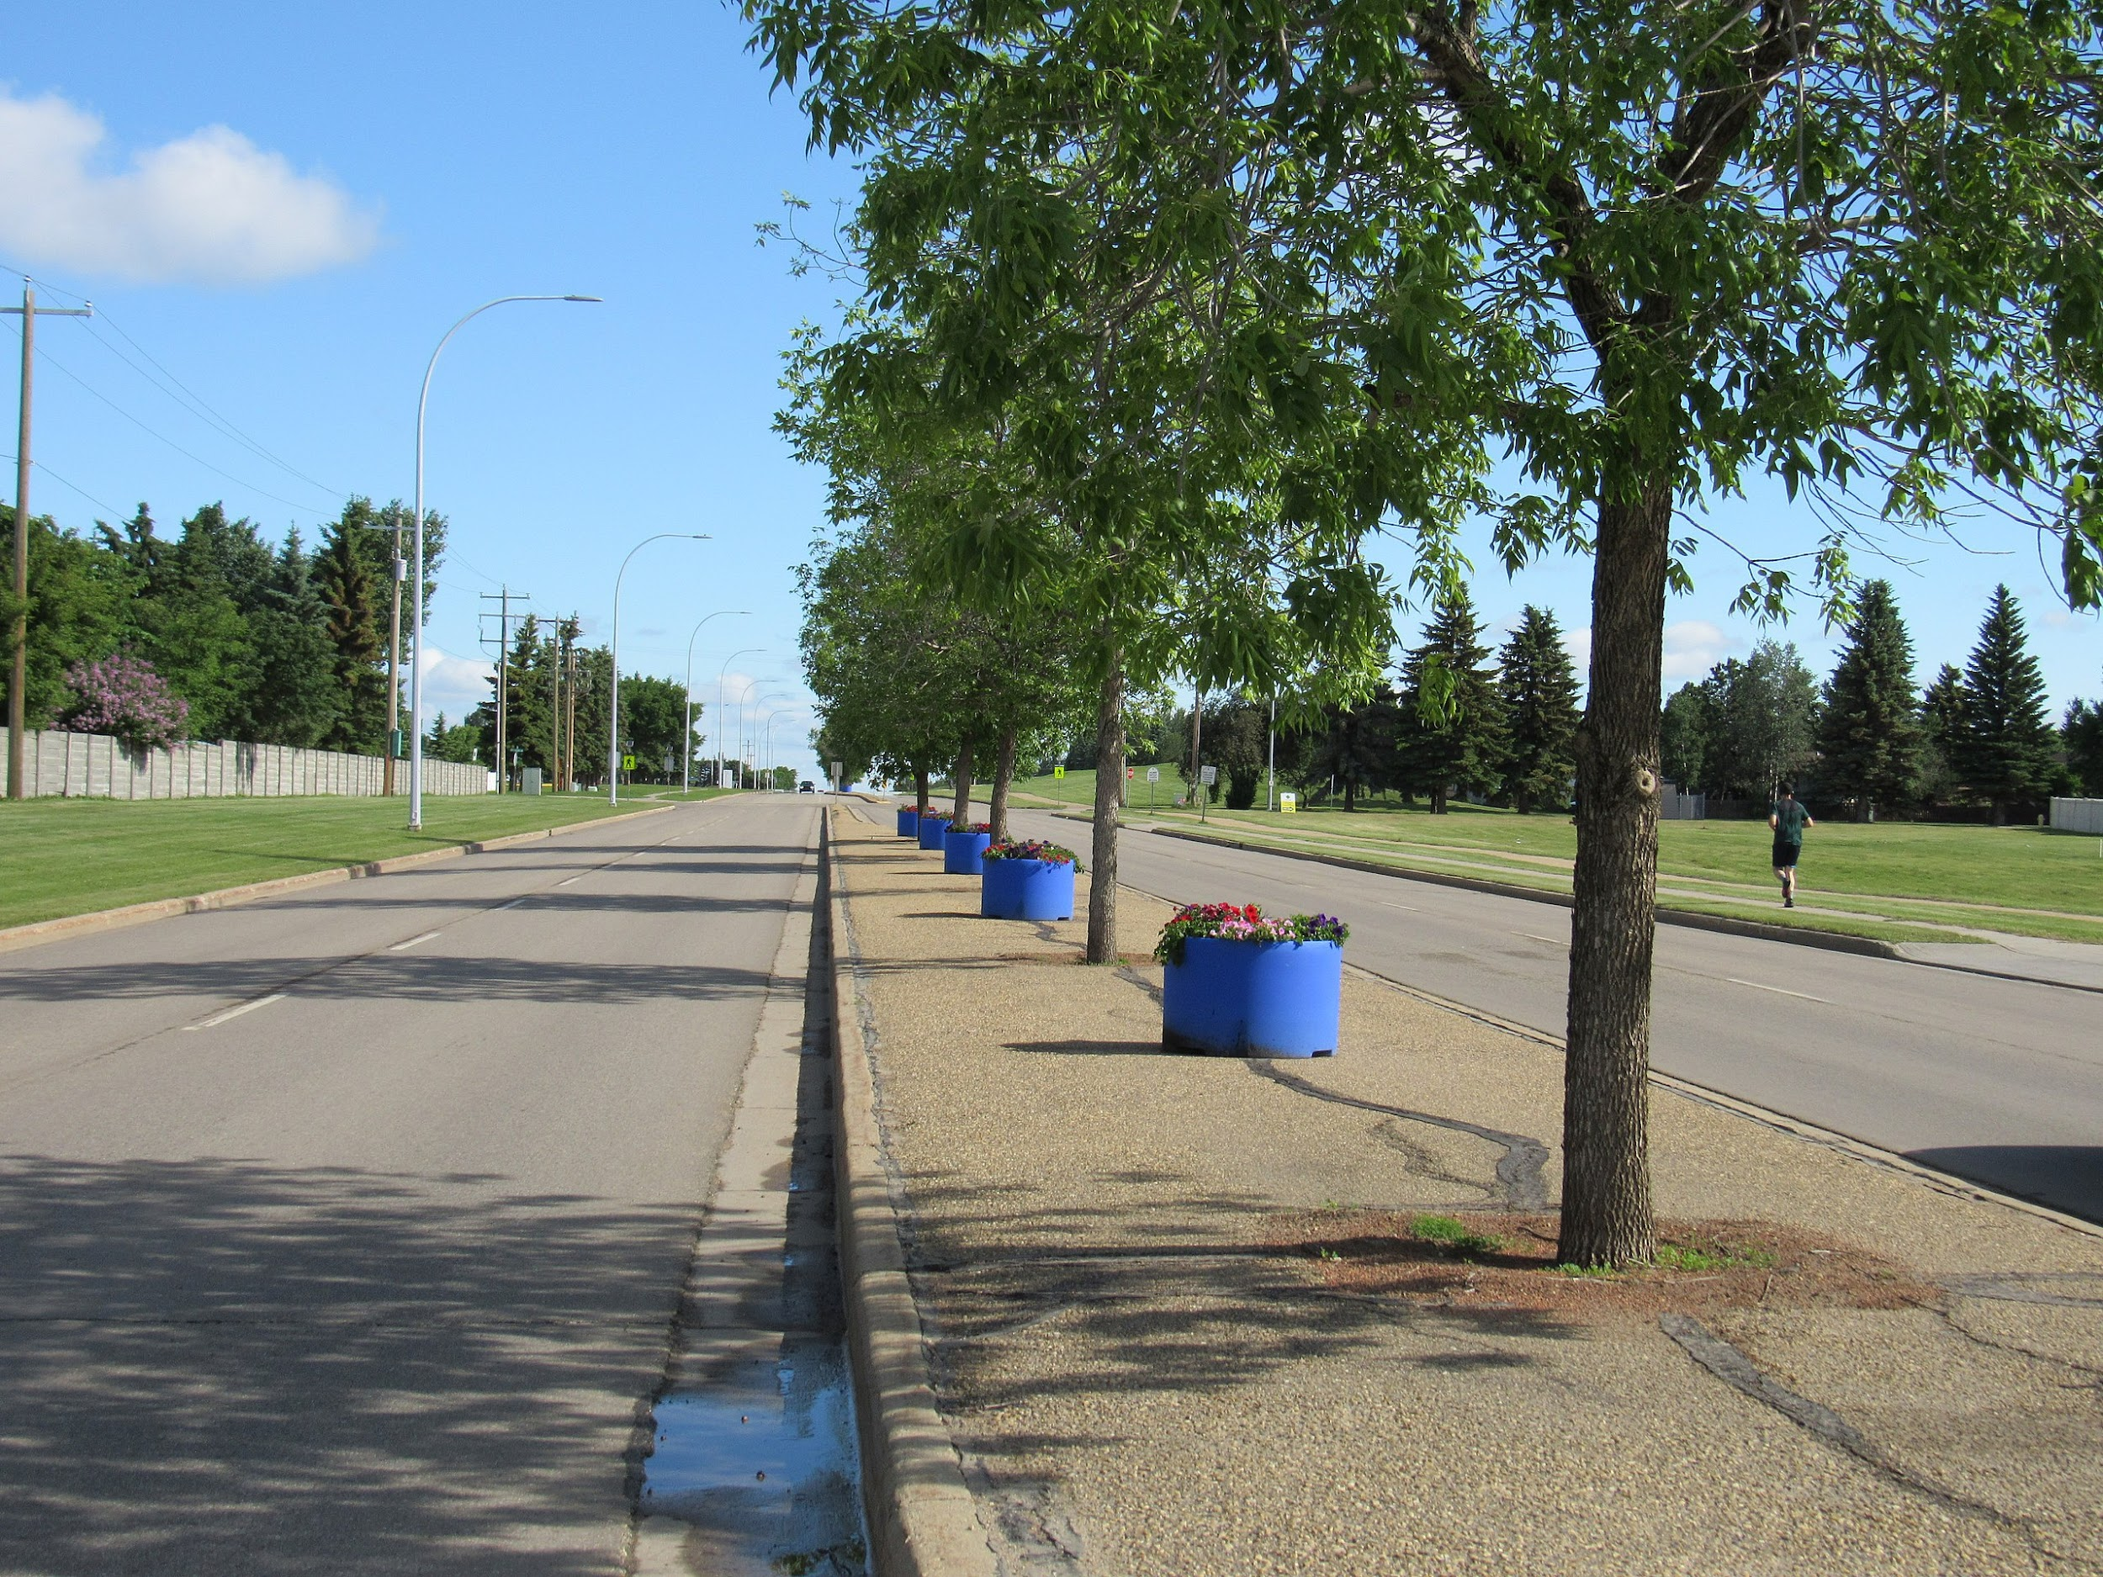
Stakeholder | Buffelgrass Area of Concern
Homeowners Association HOA (an organization that makes and enforces rules and guidelines for a subdivision, planned community, or condominium building.) | The neighborhood is located next to the city’s Urban Trail used by joggers, cyclists, walkers, etc. The Urban Trail is asphalt, but is bordered by significant patches of land infested with Buffelgrass.
Rancher (owns 150 head of cattle) | Although the US outlawed Buffelgrass in the 1980s, Mexico still plants Buffelgrass. This rancher’s land borders Sonora, Mexico. This rancher has 350 acres of land bordering Sonora. Significant stretches of the rancher’s fence line border buffelgrass patches.
Arizona Department of Transportation (transportation agency responsible for planning, building,operating maintaining highways & is involved with maintaining public transportation and municipal ↑↟airports | From Tucson to Mexico, along the 1-19 corridor, several areas are infested with Buffelgrass. These areas border I-10 in both directions. More than 12 medians have been identified as being infested with Buffelgrass.

Slide 6
Median = middle section dividing a road or highway

Slide 7
Evaluate each Stakeholder’s plan and choose which Stakeholder’s plan should be implemented and why. Make sure you use evidence as you argue why the Stakeholder’s plan you support is the best solution.
Argument - Provides reasons the reader should accept your claim or explanation of which Stakeholder should be considered most important with best proposed solution | Not Yet | Approaches Expectation | Meets Expectation | Advanced
Point Scale | 1 | 2-3 | 4 | 5
Cites specific and relevant evidence to support argument
Describes how evidence supports and defends argument
Reader feels compelled to accept your argument
Uses appropriate content vocabulary accurately
Notes:
Teacher review Rubric and encourages students to refer to the Rubric as they evaluate and review their answers

